Slide 1
Customer Segmentation
Use of Unsupervised Learning Algorithms in Market Analysis
Susannah Bear Garlid
Notes:
Good morning. My name is Susannah Garlid. Over the next 8 minutes I will present findings on the best possible customer segments for our fine foods market using the customer data provided to the data science team.

Slide 2
Agenda
Executive Summary
Problem Statement
Approach
Process Flow
Clustering Output
Recommendations
Notes:
Here is our agenda for the meeting. We will begin with an executive summary, followed by a more in-depth problem statement. Next we will discuss our approach and process flow. Then we will discuss the clustering outputs of the selected algorithm. And finally, we will present our recommendations.

Slide 3
Executive Summary
Existing Trends
Customer Profiles
Customer Segments for Future Marketing Activities
From 2013 to 2014, the following trends were identified:
Diminishing revenue (dipped by 61% from 2013 to 2014)
Dropping customer acquisition (dropped by 47% from 2013 to 2014)
Poor marketing campaign conversion rates
Customer segmentation has been non-existent for this fine foods company
Historically, the company has used ATL marketing activities, including:
Mass emails
Outdoor advertising (billboards)
Mass printed fliers
An unsupervised machine learning algorithm was utilized to identify 5 major customer segments:
1. Budget –Conscious Shoppers
2. Wine Connoisseurs
3. Cooking Enthusiasts
4. Convenience Seekers
5. Foodie Adventurers
Notes:
From the years of 2013 to 2014, we observed diminishing revenue, dropping customer acquisition, and poor marketing campaign conversion rates. One reason for this may be the lack of personalized marketing strategies. Historically, we have used Above the Line marketing activities, such as mass emails and mass printed fliers. In order to reverse the trends downward trends seen between 2013 and 2014, we recommend using 5 customer segments, namely, Budget-Conscious Shoppers, Wine Connoisseurs, Cooking Enthusiasts, Convenience Seekers, and Foodie Adventurers.
Existing Trends: From the data, my team saw a major loss in revenue from 2013 to 2014. 2013 was a good year, we had upwards of $700k in revenue, but that sunk in 2013 to less than $300k in 2014. This might be explained from both dropping customer acquisition rates and marketing campaign conversion rates. The past 5 marketing campaigns revealed just 5.6% conversion, most of which were from customers who are already loyal.
Customer Profiles: Customer profiles for our company have not existed up til now. However, as technology has altered the way marketing campaigns operate, it has become necessary to employ machine learning algorithms to aid in the segmentation of customers with the end result being personalized campaigns targeted towards specific groups of customers.
After exploring a variety of unsupervised machine learning algorithms, we have settled on the K-Medoids algorithm to cluster customers into five segments: Budget-Conscious Shoppers, Wine Connoisseurs, Cooking Enthusiasts, Convenience Seekers, and Foodie Adventurers. By analyzing customer purchase channels and website interactions, we have developed recommendations for a mixture of both digital and print advertisements aimed at boosting campaign conversion rates, acquisition rates, and ultimately sales revenue.

Slide 4
Problem Statement
Our fine foods market aims to improve customer acquisition, retention, and revenue for the next fiscal year by employing customer segmentation and personalized marketing campaigns for existing customers.
Current State
Gap
Future State
Our fine foods market specializes in a variety of fresh meats, fruits, sweets, wines and gold products. In 2014, there were 2,240 registered customers who purchase items in store, online and via catalog.
Both revenue and customer acquisitions rose from 2012 to 2013 and dropped from 2013 to 2014
Revenue sunk from 2013 to 2014 by 61.8%, from $715,425 in 2013 to $273,294 in 2014.
Customer acquisition dipped from 1189 to 558 from 2013 to 2014, respectively
Campaign conversion rates reveal conversions from the past 5 campaigns to be around 5.6%, which is less than the recommended 10%-11.45% that some marketing consultants recommend (Berry).
Customer segmentation has been non-existent for the company, but with the advent of machine learning and personalized marketing strategies currently employed by competitors, it has become necessary to utilize the same technology to stay afloat in today’s competitive marketplace.
Customer segmentation and personalized marketing have been reported to grow revenue by 6-7 times. We will use customer segmentation and personalized marketing to achieve our goals for the next fiscal year, which are:
Increase customer campaign conversions by 5%-7%
Increase customer retention by 5%
Increase revenue by 10%-15%
Notes:
Delving a little deeper into our problem statement, we see revenue dropped by 61.8% from 2013 to 2014. Customer acquisition dropped by 47%, and campaign conversion rates for the last 5 campaigns hovered around 5.6% on average.
We believe the issue lies in the lack of customer segmentation and personalized strategies currently employed by competitors.
From external research, have come to realize that market segmentation and personalized marketing grow revenue by 6-7 times. Therefore, we recommend utilizing these for the next fiscal to achieve the company’s goals which include: increasing customer campaign conversions by 5-7%, increasing customer retention by 5%, and increasing revenue by 10-15%.
Current State: In 2014, the fine foods market had a little over 2,000 registered customers. These customer used various purchase channels, mainly in-store, but also via online and catalog purchases. As aforementioned, we saw an increase in both customer acquisition and revenue from 2012 to 2013, but saw a dip from 2013 to 2014. Additionally, the last 5 campaigns revealed conversions around 5.6%, which is less than the ideal 10%-11.45%.
Gap: Customer segmentation and personalized marketing strategies have not been used by this company as of yet. But with the advent of more powerful computers and clustering machine learning algorithms, it has become necessary to employ algorithms to stay afloat in today's competitive marketplace.
Future State: From outside research, we understand that customer segmentation and personalized marketing strategies have proven to increase revenue by 6-7times. With this in mind, our goals for the next fiscal year include increasing customer campaign conversions by at least 5%, increasing customer retention by at least 5%, and growing revenue by 10%-15%.

Slide 5
Process Flow
The data science team utilized a five-step process to identify customer segments for the fine foods market.
Data Collection
A dataset was provided to the data science team at the commencement of the project.
Data Preprocessing
The data science team performed a series of quality checks, including imputing missing data, identifying extreme outliers, and making the data more uniform
The dataset included demographic information, amounts spent on various product categories, purchase channels, and accepted/rejected marketing campaigns
Exploratory Data Analysis
Exploratory data analysis was used to identify key variables and customer trends.
Cluster Analysis
A variety of clustering algorithms were analyzed in an effort to select the algorithm that best grouped the data.
Recommendation
The analysis was then used to formulate recommendations for the marketing team based on key characteristics of each customer segment.
Cluster validation measures (ie, Silhouette score) were used to find the algorithm of best fit.
This information was later used to decide which attributes to use for clustering.
Notes:
The data science team utilized an industry standard five-step process to identify customer segments for our fine foods market. These steps included: Data Collection, Data Preprocessing, Exploratory Data Analysis, Cluster Analysis, and finally recommendations.
Preprocessing:
1.07% (24) of the income values were missing, so we imputed those using the median value of income
Replaced relationship statuses "YOLO" "Absurd" and "Alone" with "Single". Also replaced "2n Cycle" with "Masters"
Also birth year was from 1893 to 1996. The 1893 was likely inaccurate.
EDA:
Summary statistics of numeric variables – noticed the and extreme outlier for income was +$600k. Also noticed other extreme values where income was over $150k. There were 8 of these observations, and we deleted these.
Looked at categorical variables in the dataset
Performed univariate and multi-variate analysis
Noticed trends such as the most money was spent on wines and meats out of all the products. Also noticed that there seemed to be a preference for in-store purchases vs web or catalog. Other trends included the majority of the customers are married or in a relationship (25.8% were together, 38.6% were married = 64.4%), 50% of the customers had a Bachelor's degree, and most of the customers either did not have children in the home or had a child in the home.
Also did some feature engineering such as obtaining the age of the customers from the year of birth, constructing family size based on number relationship status and number of children + teens in the home, calculating total number of expenses and purchases, and discovering the number campaigns accepted.
We observed positive correlations between products purchased as well as income and amount spent on products
We observed negative correlations between income and family size
Cluster Analysis
After EDA We dropped columns, such as education, marital_status, Kids, and Teenhome. The reason was we wanted to see behavioral attributes that were not revealed in categorical variables.
Next, we scaled the data so that all features would have a similar size with a mean of 0 and a variance of 1. We wanted to bring down all the features to a common scale without distorting the differences in the range of values.
Following scaling the data, we performed Principal Component Analysis, which reduced our dimensions from high-dimensional data to lower-dimensions (while retaining as much of the original variance as possible). We captured the essential patterns and relationships in the data by identifying a new set of uncorrelated variables (called principal components). PCA reduced the multicollinearity between our variables (see appendix for scatter plot of two principal components) (See appendix for 2D plot of first 2 principal components)
Then explored different clustering algorithms such as K-Means, K-Medoids, Hierarchical Clustering, Density-Based Spatial Clustering of Applications with Noise (DSBCAN), and Gaussian Mixture Models.
To select the best fit model, we looked at the Silhouette score for each algorithm (which we will see on the next slide)
Recommendation
Lastly, we analyzed the clusters produced by our selected algorithm to identify customer behaviors within each segment. We used our analysis to make recommendations for the marketing team.

Slide 6
Cluster Output
The K-Medoids clustering algorithm was the least sensitive to outliers and produced the most compact segments observing the highest silhouette score.
Clustering Algorithm | Definition | Number of Segments | Silhouette Score
K-Means | A clustering method that aims to group a dataset into a selected number of clusters, where each data point belongs to a different group with the nearest mean. | 5 | 0.328
K-Medoids | A variation of K-Means that uses the most centrally located data points (“medoids”) instead of the means for cluster representation. It is less sensitive to outliers than K-Means. | 5 | 0.339
Hierarchical Clustering | Agglomerative clustering method that creates a hierarchy of clusters by using a dendrogram to iteratively merge or divide clusters until a hierarchy is formed. | 5 | 0.312
Density Based Spatial Clustering of Applications wiht Noise (DBSCAN) | Clustering method that groups together data points that are close to each other and have a sufficient number of nearby neighbors. Excellent for data with arbitrary shapes and lots of noise. | 5 | 0.177
Gaussian Mixture Model (GMM) | “Soft” clustering method that uses a Gaussian distribution to identify a customer’s probability of belonging to one cluster. | 5 | 0.102
Notes:
During cluster analysis, we analyzed 5 different clustering algorithms, as seen on the left. We selected the best-fit algorithm by using the industry standard Silhouette score in addition to the algorithm that is most robust to outliers. Here we see K-Medoids has the highest silhouette score and is the most robust to outliers. Therefore, K-Medoids was selected as the algorithm of choice.
As aforementioned, we explored the algorithms listed in the left-most column. At first, we explored using 3 clusters (based on elbow method, which can be seen in the appendix) , but using 3 didn't reveal purchasing patterns and behaviors in the data. Rather, the algorithm seemed to cluster the data according to income (low, medium, and high incomes). Referring back to the Elbow chart, there was another slight dip at K = 5. Using K = 5 seemed to give us a better idea of out each segment shopped, what they purchased, and how much they spent. So we used 5, and from the chart here we see that K-Medoids had the largest Silhouette score. Additionally, since K-Medoids uses the most centrally located data point to cluster around (instead of a mean like K-Means uses), the algorithm is less sensitive to outliers. We did handle outliers in our data preprocessing and EDA steps, but this will help as a catch-all for future use. Other clustering methods are not as robust to outliers, therefore, we selected K-Medoids.

Slide 7
Key Characteristics of Customer Segments
Customer Segments |  | Demographic Averages |  |  | Purchase Averages |  |  | Purchase Channel Preferences
Segment # | Segment Name | Age | Income | Family Size | Total # of Purchases | Purchase Amount | Product Most Purchased | 2nd Most Preferred Channel
0 | Budget-Conscious Shoppers | 45 | $33,631 | 2.9 | 9 | $12.44 | Gold | Web
1 | Wine Connoisseurs | 48 | $77,802 | 1.8 | 1778 | $92.91 | Wine | Catalog
2 | Cooking Enthusiasts | 50 | $69,836 | 2.2 | 1145 | $54.84 | Most Goods | Web
3 | Convenience Seekers | 46 | $37,434 | 2.9 | 97 | $10.82 | Gold | Web
4 | Foodie Adventurers | 50 | $58,281 | 2.7 | 611 | $30.62 | Fish | Web
CHEMICAL
Inherited: Joint mutation via natural selection
Acquired: Chromosomal mutation
Radiation exposure
Drug treatments
Industrial toxins
Notes:
In analyzing the clusters produced by K-Medoids, we identified key characteristics of each segment. We see 5 segments, namely [name each one]. Each have different income levels, family sizes, purchase averages and purchase channel preferences.

Slide 8

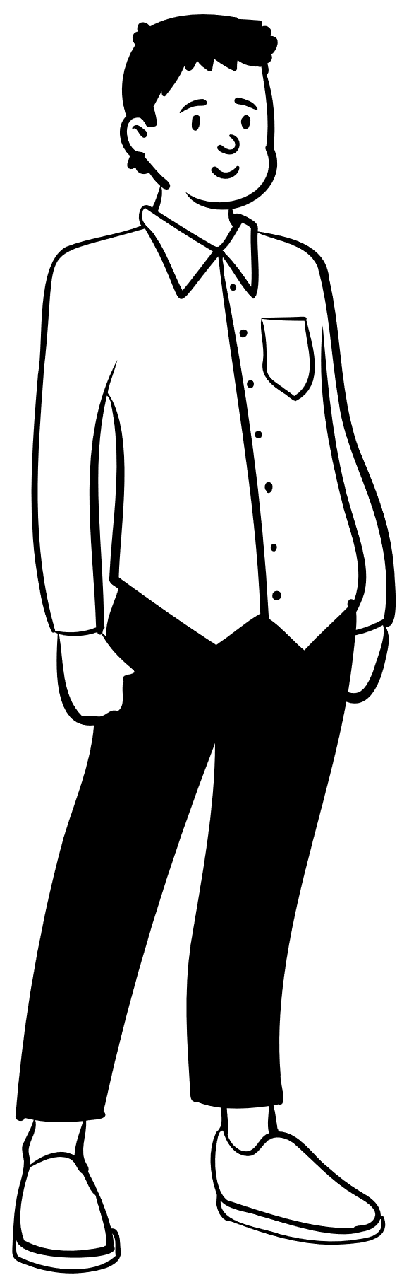
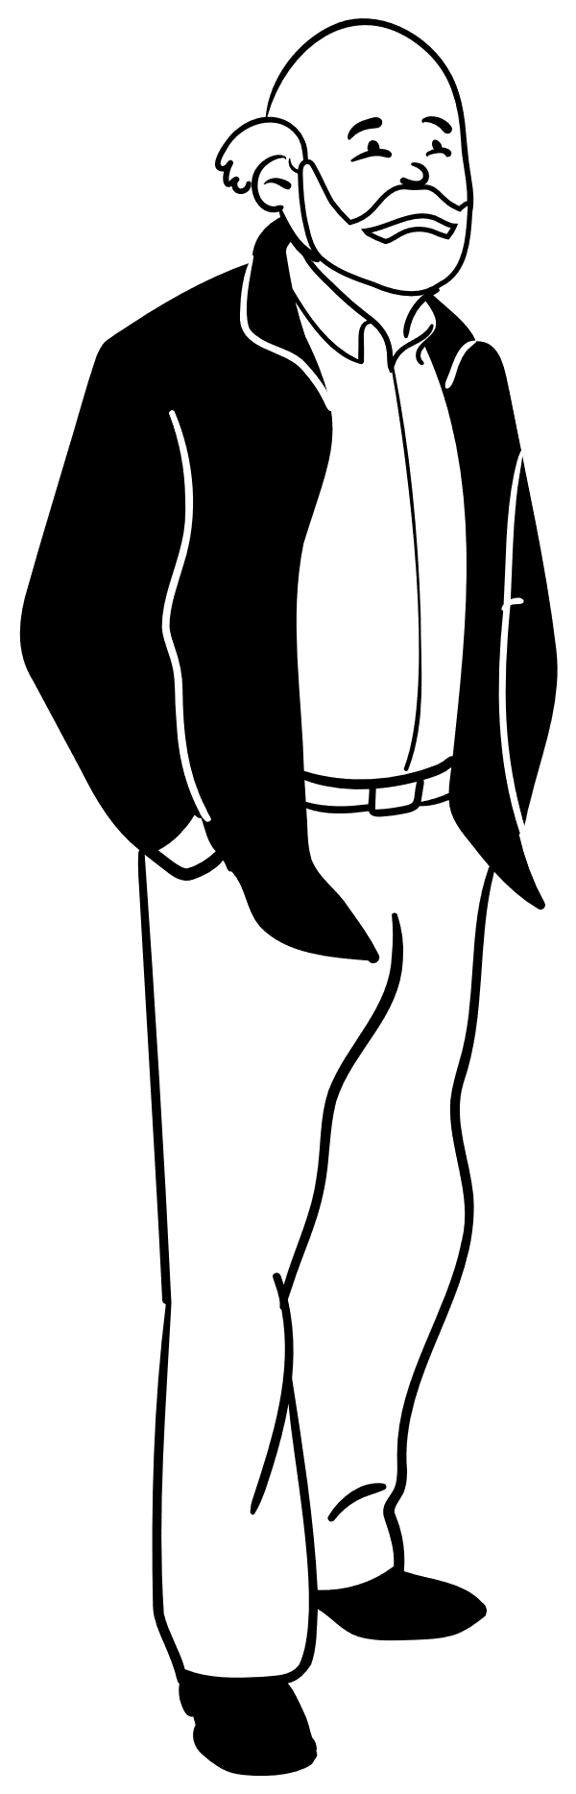
Customer Personas
Based on key characteristics of customer segments, the data science team has created personas for each segment This will help give marketing an idea of who they are targeting.
Budget-Conscious Shoppers:
Low-income parents who appreciate fine foods but who can’t afford fine foods without deals
Cooking Enthusiasts:
Empty-nesters with enough money to spend on ingredients to satisfy any hobby-chefs cooking dreams
Wine Connoisseurs:
Wealthy, childless couples who enjoy (and can easily afford) fine foods, especially wines
Convenience Seekers:
Busy parents who seek markets in which they can purchase items for the whole family rather than items only mature palettes would enjoy
Foodie Adventurers:
Always on the hunt for fresh meats and exotic fruits, these middle-aged parents seek deals so they can enjoy fine foods without blowing the budget
Notes:
In addition to key-characteristics, we have also created customer personas based on each segments purchasing behavior. We see the following.

Slide 9


Recommendations
Customizing both marketing content marketing medium may help the company to achieve the desired future state
Budget-Conscious Shoppers
Marketing Content: Deals & discounts on wine, meats, and gold products
Marketing Medium: Website and Email Marketing
Wine Connoisseurs
Marketing Content: New wines and high-end meats
Marketing Medium: Printed advertisements, such as mailers or ads in the newspaper
Cooking Enthusiasts
Marketing Content: Wines, meats, fish, and fruits and discounts on these items.
Marketing Medium: Both internet advertisements and printed advertisements
Convenience Seekers
Marketing Content: Easy-to-prepare foods for the whole family to enjoy
Marketing Medium: Internet advertisements
Foodie Adventurers:
Marketing Content: New, different, or adventurous wines, meats, fish, fruits and sweets
Marketing Medium: Internet advertisements
Notes:
We believe that customizing both marketing content and marketing medium may help the company to achive the desired future state. Here we have recommendations for each customer segment for both marketing content and marketing medium.

Slide 10
Recommendations
Estimated costs of advertising to different segments
Segment # | Segment Name | # of Customers in Segment | Medium 1 | Medium 2 | Cost of Medium 1 | Cost of Medium 2 | Advertising Cost Per Segment Per Campaign (Both Mediums Included)
0 | Budget-Conscious Shoppers | 518 | Website (Google Display Ads) | Email Marketing | $0.67 | $0.04 | $367.78
1 | Wine Connoisseurs | 258 | Magazine | Direct Mail | $1.00 | $0.50 | $386.17
2 | Cooking Enthusiasts | 447 | Email Marketing | Direct Mail | $0.04 | $0.50 | $241.38
3 | Convenience Seekers | 584 | Website (Google Display Ads) | Email Marketing | $0.67 | $0.04 | $414.64
4 | Foodie Adventurers | 420 | Website (Google Display Ads) | Email Marketing | $0.67 | $0.04 | $298.20
Total Cost |  |  |  |  |  |  | $1,708.17
Notes:
Additionally, we have provided cost estimates for marketing to various segments based on marketing medium.

Slide 11
Q&A

Slide 12
Thank you
Susannah Bear Garlid
susannahb@dcisoftware.com

Slide 13
Appendix
Notes:
Technical slides

Slide 14
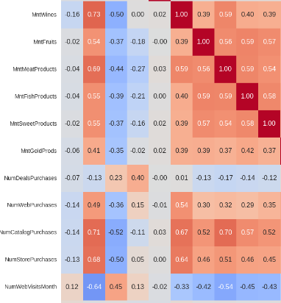

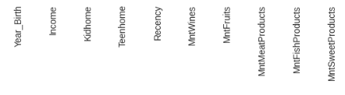
Bivariate Analysis
The graphic on the right shows a portion of the correlation matrix for numeric features. We see strong positive correlations between amount spent on wine and meat, income and amount spent on products, etc. We also see negative correlation between Kidhome and amount spent on items, particularly wine.

Slide 15
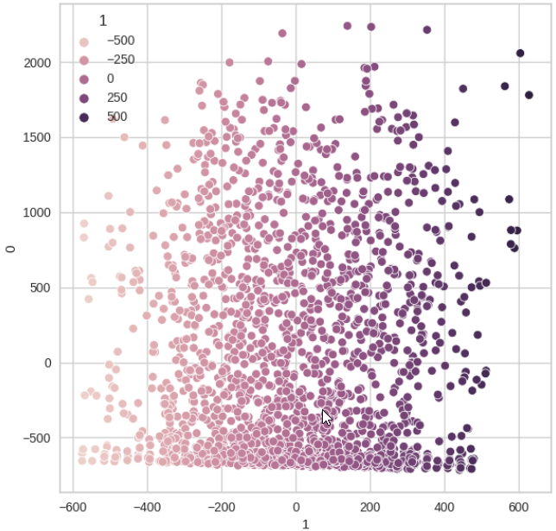
Principal Component Analysis
2D Scatterplot of the first two principal components after performing PCA

Slide 16
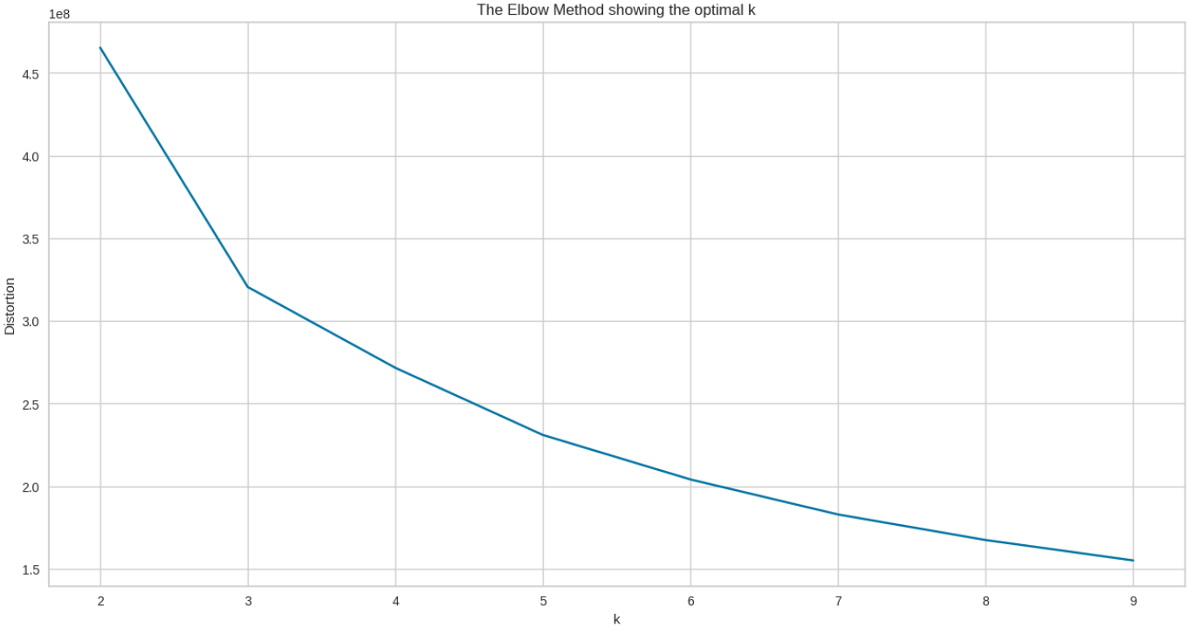
Elbow Method
Identifying the optimal number of clusters in K-Means

Slide 17
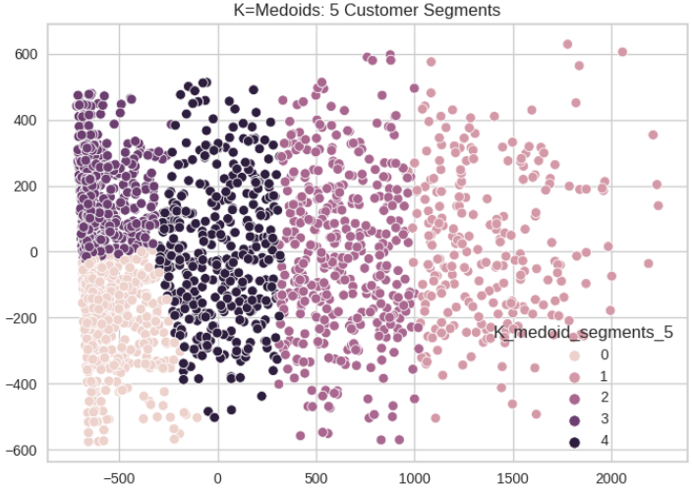
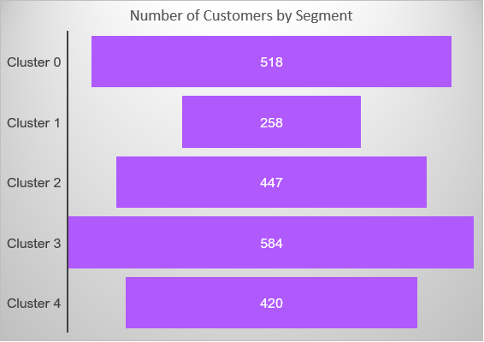
Cluster Output
K-Medoids Cluster Output: 2D Plot
Funnel Chart Depicting # of Customers

Slide 18
Works Cited
Berry, Sarah. “What Is a Good Conversion Rate? (And How Does Yours Compare?).” WebFX, 6 April 2023, https://www.webfx.com/blog/marketing/what-is-a-good-conversion-rate/. Accessed 3 December 2023.
“Catalog Printing & Mailing (How Much It Costs & More).” Conquest Graphics, 3 May 2023, https://www.conquestgraphics.com/blog/conquest-graphics/2018/10/10/how-much-does-it-cost-to-print-catalogs. Accessed 15 December 2023.
“How Much Does Email Marketing Cost? Pricing Guide 2024.” Email Vendor Selection, 10 December 2023, https://www.emailvendorselection.com/email-marketing-cost-pricing-guide/. Accessed 15 December 2023.
“How Much It (Truly) Costs to Mail 1000 Flyers + How To Get Discounts.” Conquest Graphics, 8 December 2023, https://www.conquestgraphics.com/blog/conquest-graphics/2022/11/14/how-much-it-(truly)-costs-to-mail-1000-flyers-how-to-get-discounts. Accessed 15 December 2023.
“Online Advertising Costs In 2021 | Top Draw.” Top Draw Inc., 26 March 2021, https://www.topdraw.com/insights/is-online-advertising-expensive/. Accessed 15 December 2023.

